Slide 1
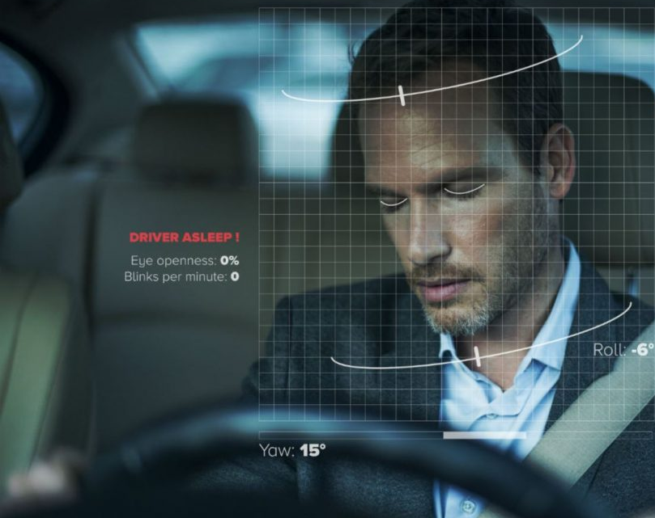
TEAM-23
Driver Drowsiness Detection System

Slide 2
ABSTRACT
“1 in 25 adult drivers report that they have fallen asleep at the wheel in the past 30 days”
If you have driven before, you’ve been drowsy at the wheel at some point. It’s not something we like to admit but it’s an important problem with serious consequences that needs to be addressed. 1 in 4 vehicle accidents are caused by drowsy driving and 1 in 25 adult drivers report that they have fallen asleep at the wheel in the past 30 days. The scariest part is that drowsy driving isn’t just falling asleep while driving. Drowsy driving can be as small as a brief state of unconsciousness when the driver is not paying full attention to the road. Drowsy driving results in over 71,000 injuries, 1,500 deaths, and $12.5 billion in monetary losses per year. Due to the relevance of this problem, we believe it is important to develop a solution for drowsiness detection, especially in the early stages to prevent accidents.
Additionally, we believe that drowsiness can negatively impact people in working and classroom environments as well. Although sleep deprivation and college go hand in hand, drowsiness in the workplace especially while working with heavy machinery may result in serious injuries similar to those that occur while driving drowsily.

Slide 3

LITERATURE REVIEW

Slide 4
LITERATURE REVIEW
We as a Team, have studied various resources to learn about the different methods and to learn about the uses and effectiveness of the concepts i.e., machine learning concepts
We used the available means to avail the resources ,we mainly used Internet as the primary source.
The international journal of engineering research and technology’s article: A Machine-Learning Approach for Driver-Drowsiness Detection based on Eye-State, the article suggests, “Generally, the driving person feels drowsy due to continues driving for long hours or Physical illness or might be drunken and this leads to major road accidents. Our aim is to detect the drowsiness, make them alert to prevent accidents and generate a notification in the app and an alarm sound.”
Detection and prediction of driver drowsiness using artificial intelligence, suggests, that the driver drowsiness, can be monitored through different parameters such as ,eye monitoring,yawning,vehicle driving behaviour.
An Efficient Approach for Detecting Driver Drowsiness Based on Deep Learning, suggests different methods for the predictions, they mainly talked about 2 methods Drowsiness Detection and Prediction Based on Facial Landmarks and prediction based on the vehicle drive pattern detection, they concluded by saying facial landmarks as the best methodology.

Slide 5
GITHUB SETUP

Slide 6
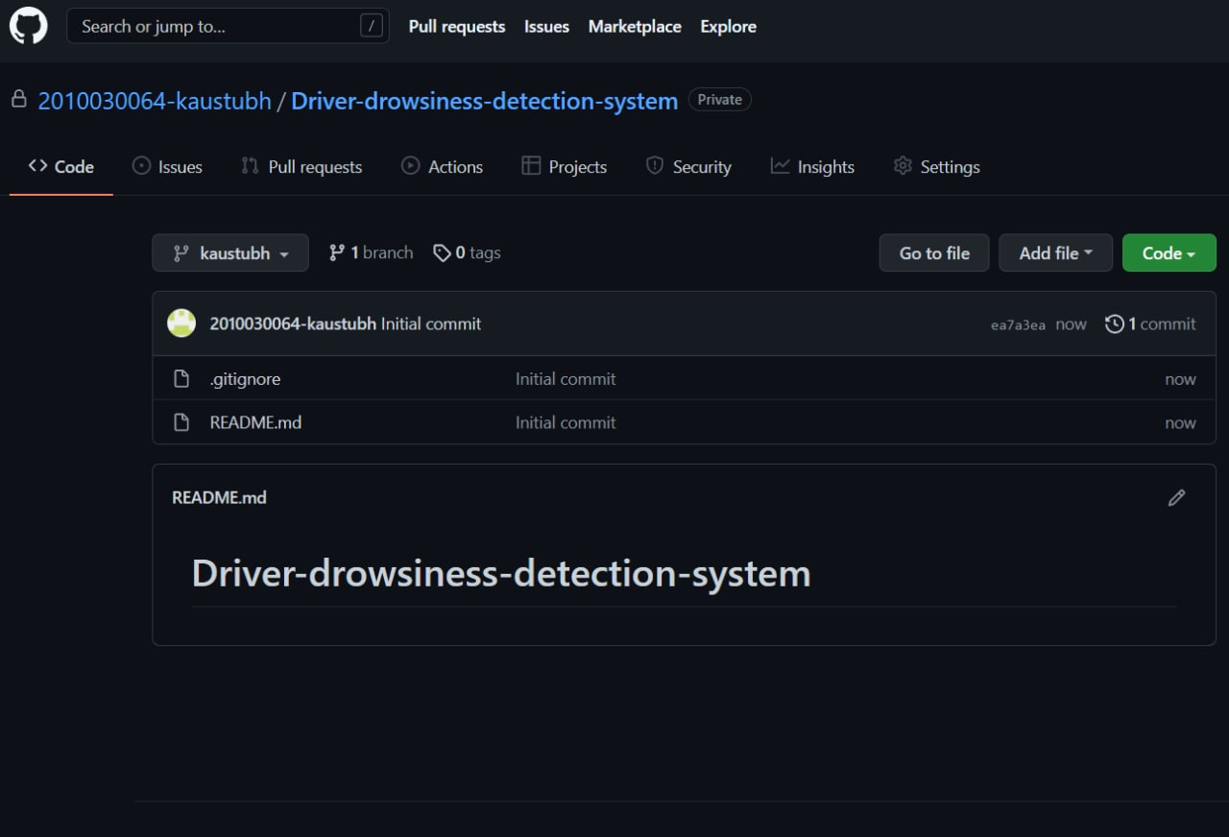
We have created a repository with the project title

Slide 7

DATA SET COLLECTION

Slide 8

We have used a dataset which was found online ,which contains the data about the eye ,talking in brief it contains different images of the eye which are classified into closed and open,it will be used in training ,with which the system can detect whether the eye is open or closed.

Slide 9
WORK ALLOCATION
2010030309-REASEARCH AND ANALYSIS
2010030064-GITHUB SETUPS
2010030197-TOOLS
2010030457-DATA SET COLLECTION

Slide 10
METHODS
A vision-based real time driver fatigue detection system based on the distance of the eyelid has built by Dong and Wu (2005). It located the face using the characteristics of skin colors and then it detected the eyes using projection and dynamic template matching.
Steering pattern monitoring,Primarily uses steering input from electric power steering system. Monitoring a driver this way only works as long as a driver actually steers a vehicle actively instead of using an automatic lane-keeping
Physiological measurement,Requires body sensors to measure parameters like brain activity, heart rate, skin conductance, muscle activity.

Slide 11
RESULTS
Using the above concepts and research part we were able to understand the working of the project and also we were able tp conclude the type of methodology we are going to follow
After through research and analysis,we finalized the project will be developed using an AI concept called opencv and the method followed will facial analysis method.
The result/outcome will display ,if the driver is drowsy or not ,by reading his eyes and warn him.

Slide 12
CONCLUSION
Drowsy driver detection methods can form the basis of a system to potentially reduce the number of crashes related to drowsy driving.
A further developed application of the driver drowsiness detection system may involve In integration of the system directly with the vehicle.
Then vehicle ,when it detects the driver is in a path of collision and is in drowsy and unreactive state will undergo emergency braking, thereby saving the life of the driver and passengers and the lives of other vehicle passengers.

Slide 13
THANK YOU

